Slide 1







[ Benefits ]
2. About Application
Background
Application
Clear UI using map
- Based on the map, our service provide the flatform which is easy to use.
- The users can check the information they want easily in the map
Provide the data simply
- When the users register the information in our service, they can do that just answer some questions.
Easy to communicate
-To use messenger function, our service provide the network to connect the users.
Schedule

Slide 2
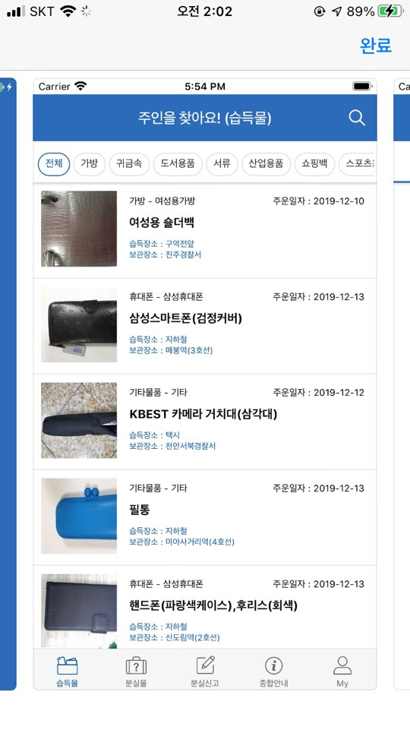
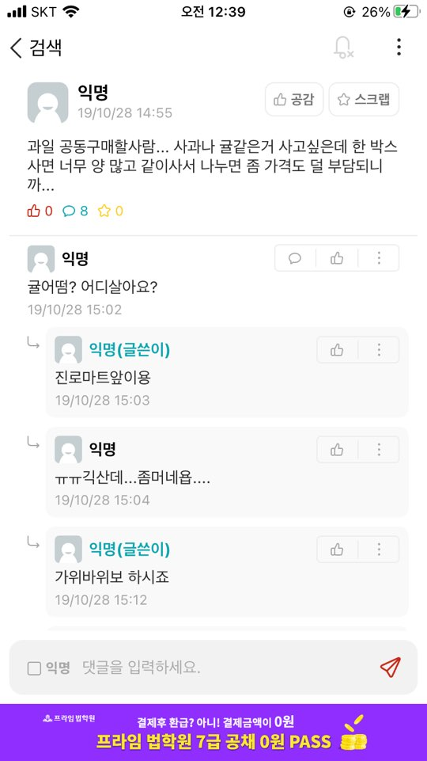
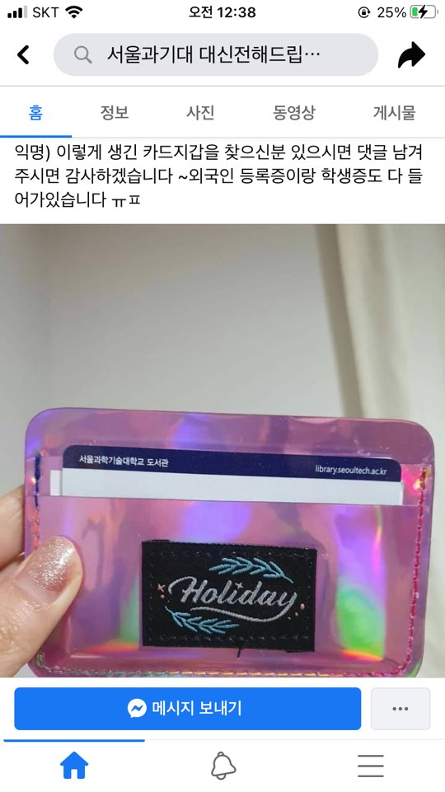
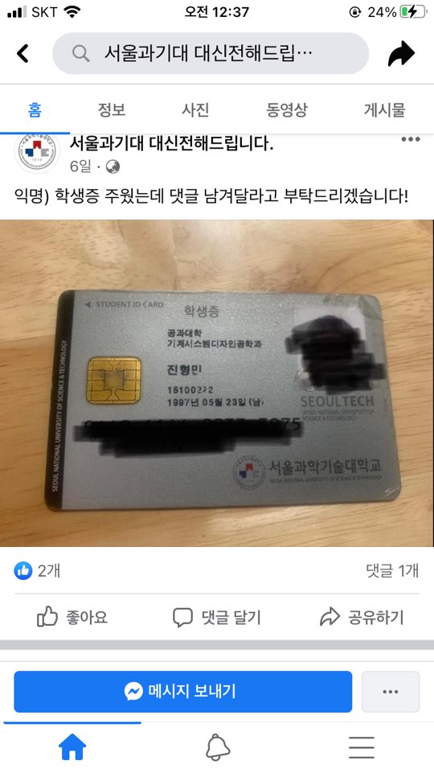
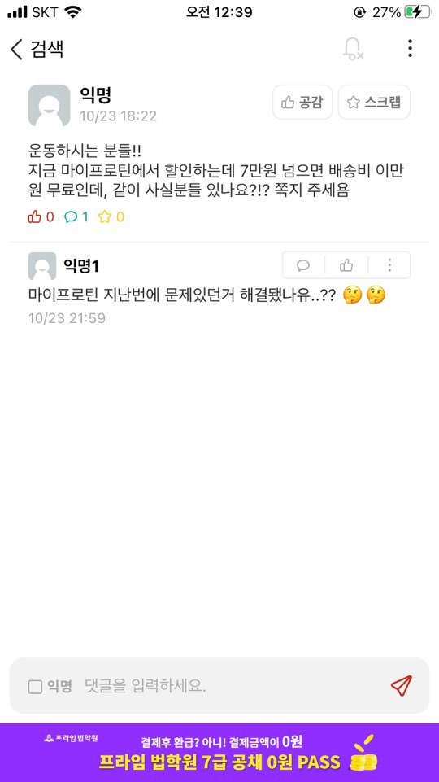
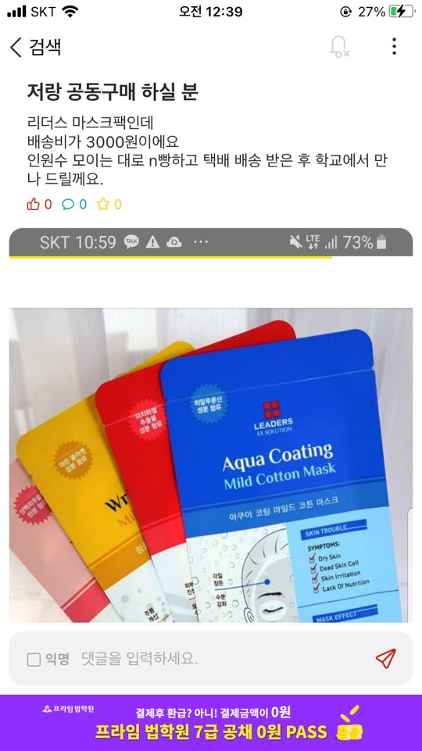
2. About Application
[ Other Application ]
Background
Application
Facebook channel
Everytime
Lost 112
Schedule

Slide 3
2. About Application
[ Other Application –Facebook channel]
Background
In the facebook channel, users request channel manager to write a post.
The users should concentrate on the post frequently.
Application
Schedule

Slide 4
2. About Application
[ Other Application –Everytime]
Background
The community of the Everytime do a role similar with the facebook channel.
It also has difficulty in checking the information at a look
Application
Schedule

Slide 5
2. About Application
[ Other Application –Lost 112]
Background
The application provide the information of the lost articles that is send in police office.
The location data is ambiguous, and it is not organized well
Application
Schedule

